Slide 1

Analytics for the Real World
Marshall Sponder,
WebMetricsGuru INC

Slide 2

Authored and Delivering the Rutgers University
Online Mini-MBA™: Social Media for the Arts
Key topics
Include:
Analyzing social media marketing opportunities for the arts
Exploring the behavioral and psychological factors that drive social media
Understanding how to form and optimize social networks for the arts
Designing effective communication strategies of social networks
Implementing measurement strategies to track and measure the ROI of social media
Discovering new social media technologies and learning how and when to employ them

Slide 3
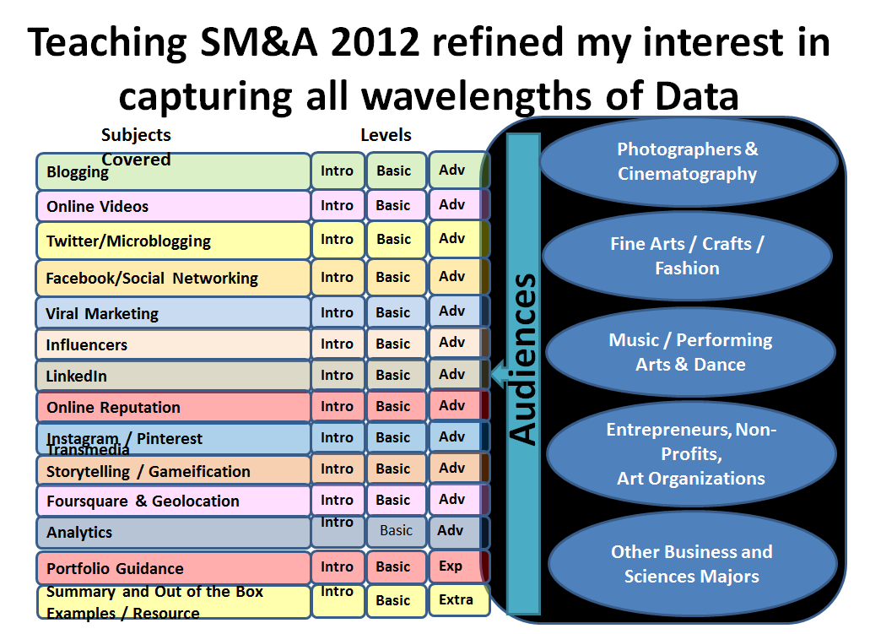

Slide 4
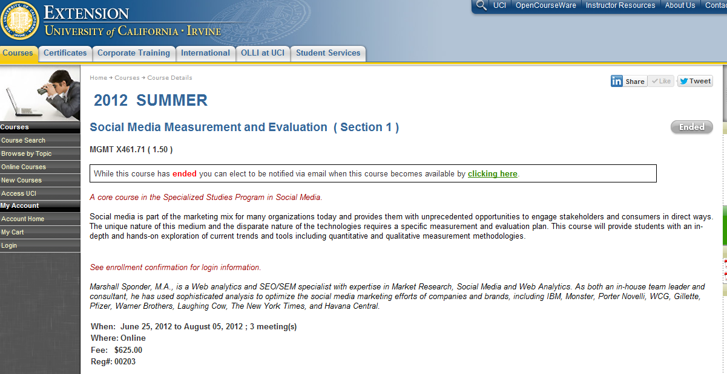
Exploring Social Data in depth at my UCI Class which is starting offered again this Winter (Jan 2013)

Slide 5
Tour of real-world upcoming sensor data with deep analytics that can change our world
  Disney Research
  Metadata enrichment project
  Google Project Glass
  Navizon Analytics
  Shopper Analytics
  Facedeals
  The GreenGoose system
  Nike+ Fuel

Slide 6
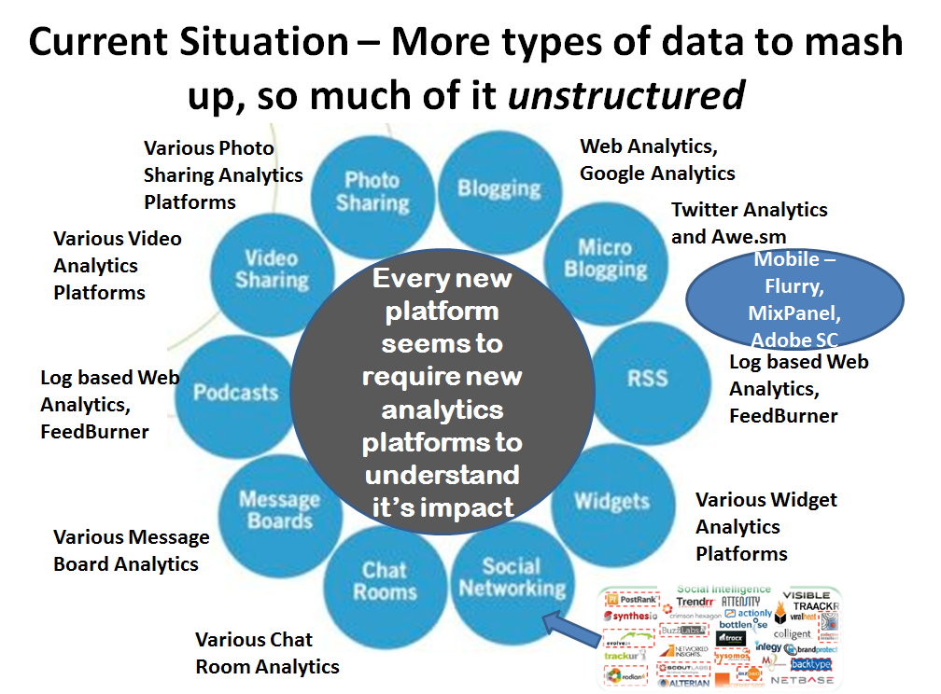

Slide 7
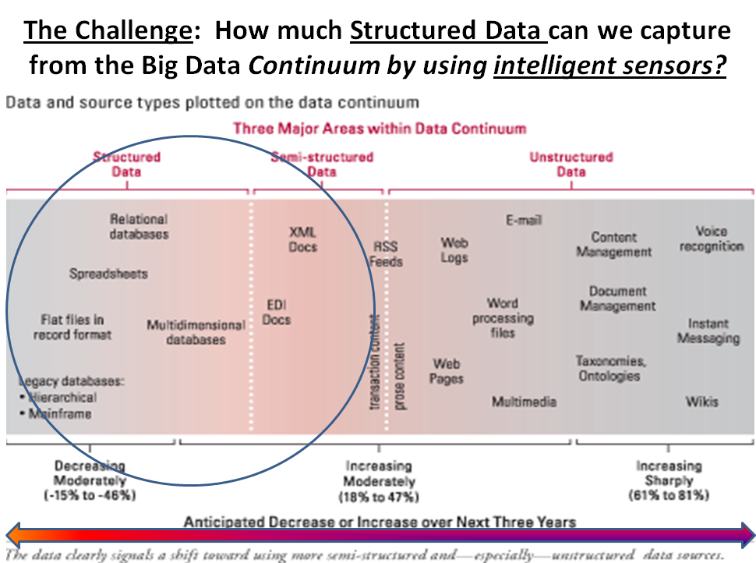
Notes:
cdn.information-management.com/media/assets/article/1082028/TDWI_fig8.gif

Slide 8
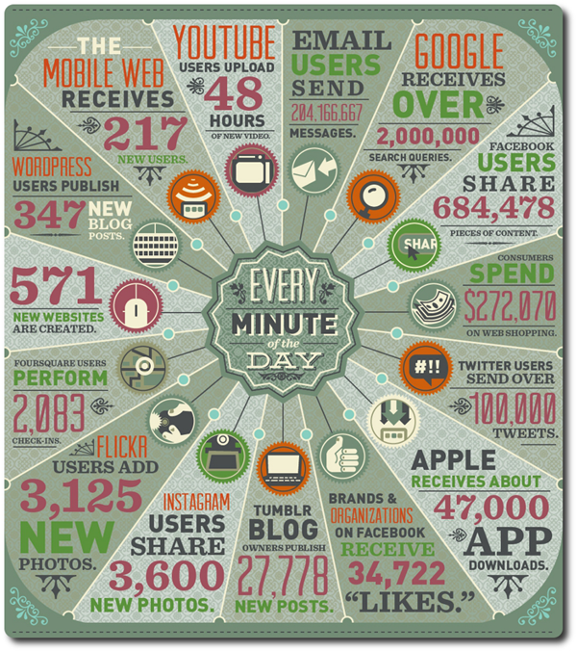

Slide 9
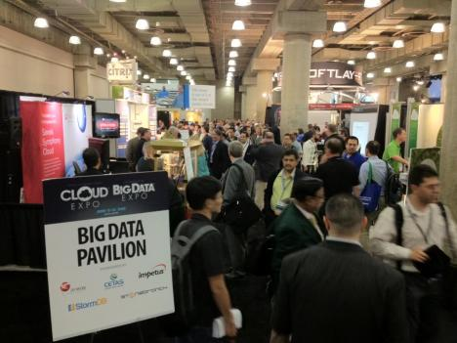
Analytics in The Near Future
Thanks to Big Data, Analytics To Be a $51B Business by 2016: IDC

Slide 10

Players in the Future of Intelligence

Slide 11

Disney Research developing a new class of 3D printed optics that embedded Analytics could reside
Source: http://youtu.be/eTeXTbXA6-Y?t=3m1s (last 30 seconds are best)
Notes:
http://www.engadget.com/2012/10/05/seeing-is-believing-disney-crafts-3d-printed-optics-video/
http://www.youtube.com/user/DisneyResearchHub/videos?view=0

Slide 12
Solving the Metadata Problem by automatically and intelligently generating it
http://geeknizer.com/camera-shoots-photos-produces-text-metadata-description/#ixzz2807mIAIi
Notes:
http://geeknizer.com/camera-shoots-photos-produces-text-metadata-description/#ixzz2807mIAIi

Slide 13
Google Project Glass and Augmented Reality provides Analytics on the 3D World
https://www.youtube.com/watch?v=9c6W4CCU9M4
Notes:
https://www.youtube.com/watch?v=9c6W4CCU9M4

Slide 14
Counting the “how many” and “when” with Navizon Analytics
http://www.youtube.com/watch?v=im3ofiyNSxY

Slide 15
Shopper Analytics is Google Analytics for the Real World
Using MS Kinect to build real world Google Analytics
http://www.youtube.com/watch?v=DbONjZ9izUo

Slide 16
Face Deals connects online and offline sales
https://www.youtube.com/watch?v=sLOxUVvcjwE

Slide 17
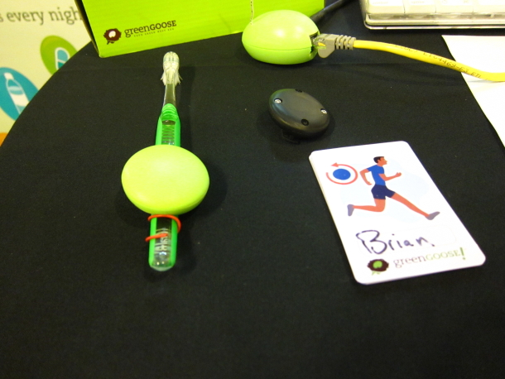
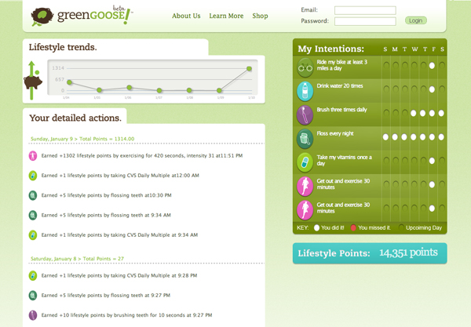
Tag Your World
Your
Personal
Analytics
Are your kids doing their chores?
http://www.fastcompany.com/1743829/green-goose-tracks-whether-your-kids-are-doing-their-chores
Notes:
http://www.fastcompany.com/1743829/green-goose-tracks-whether-your-kids-are-doing-their-chores

Slide 18
Nike+ Running fuel App for Mobile
http://nikeplus.nike.com/plus/

Slide 19
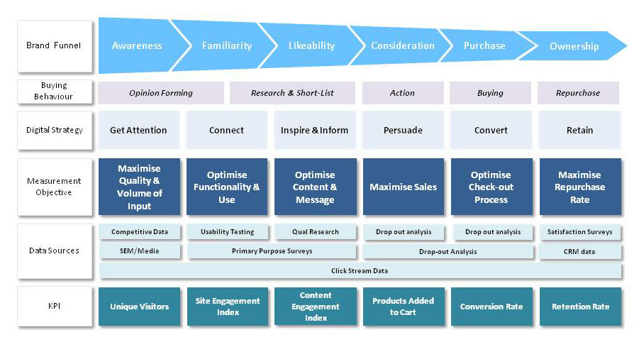
How Sensor systems inform the Analytics Frameworks
Navizon
Analytics
Green
Goose System
Google Project Glass
Nike+
Fuel
Face Deals
Shopper Analytics
Descriptive
Camera

Slide 20
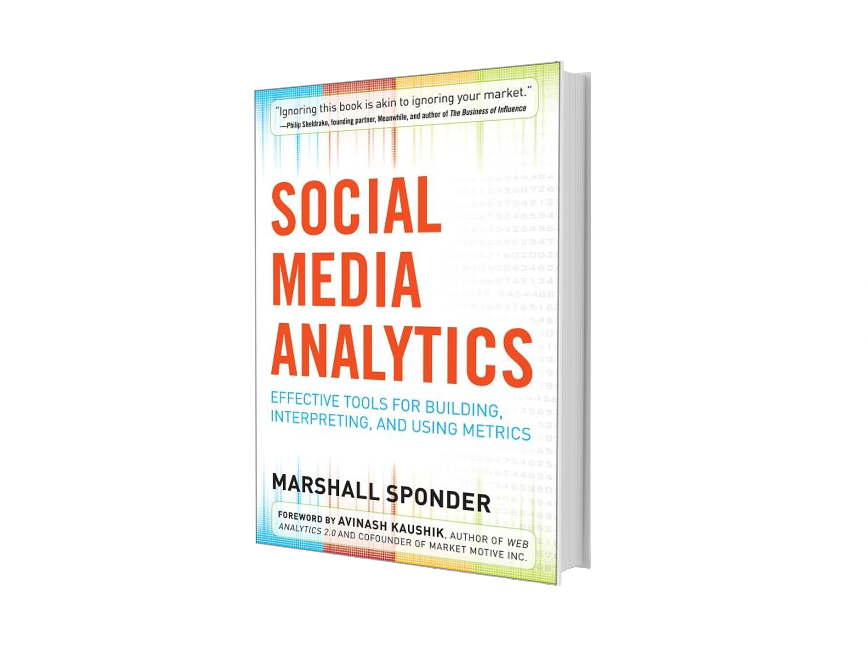
WebMetricsGuru.com
Thank You!
Marshall Sponder
WebMetricsGuru INC.
www.webmetricsguru.com
www.smabook.com
now.seo@gmail.com
@webmetricsguru
@smanalyticsbook
WebMetricsGuru INC.

